Slide 1

Data
PSY 4425
Dr. Minor

Slide 2

Why Include Data in Psychology?
Data are used to describe and explore questions and phenomena relating to the mind and behavior.
For this class, you will use data to provide descriptive information that “sets the stage” for your final project.

Slide 3
Quantitative Research
The process of collecting and analyzing numerical data. It can be used to find patterns and averages, make predictions, test causal relationships, and generalize results to wider populations.
Qualitative (non-numerical) data can be included in your project as additional support, but only quantitative analysis is required.
We will use SPSS to manage and analyze your data
You have the option of using an existing dataset posted on Canvas, or collecting your own survey data.

Slide 4
Quantitative Analysis (RMS I Review)
You should all be familiar with running basic analyses in SPSS from Research Methods and Statistics I.
The analytic procedures are presented below:
Analysis | SPSS Command | Relevant Output
Frequencies | Analyze → Descriptive Statistics → Frequencies | Percentages for individual items
Descriptive Statistics | Analyze → Descriptive Statistics → Descriptives | Mean, SD, Min, Max
Correlations | Analyze → Correlate → Bivariate Correlation | Statistic = r Significance = p
Independent Samples t-test (for differences in 2 groups) | Analyze → Compare Means → Independent Samples t-Test | Statistic = t Significance = p
ANOVA (for differences in >2 groups) | Analyze → Compare Means → One-Way ANOVA | Statistic = F (df_{bet}, df_{within}) Significance = p

Slide 5
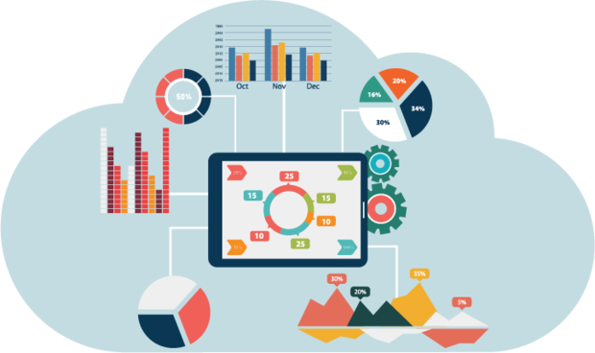
Data Reporting
Due Date: April 28th
Required components
Write-up of analyses
Table, Figure, or Graph that illustrates the most relevant conclusions

